Slide 1

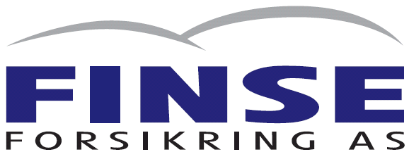
Reinsurance Presentation
Vygruppen AS
September
2025

Slide 2
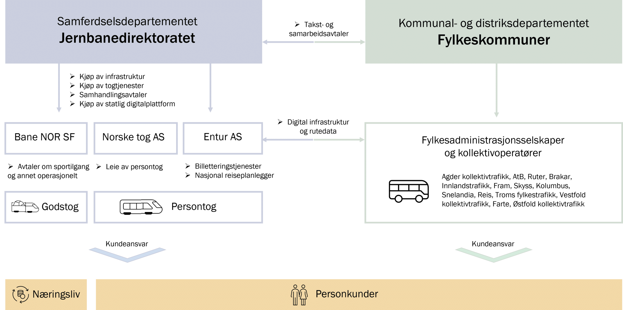
Norwegian Railway framework
As per 2015
Reformed Railway Sector
For a description of the actors in english, please read the following web-page:
https://www.jernbanedirektoratet.no/en/the-norwegian-railway-sector/#railway-companies-passenger-traffic

Slide 3
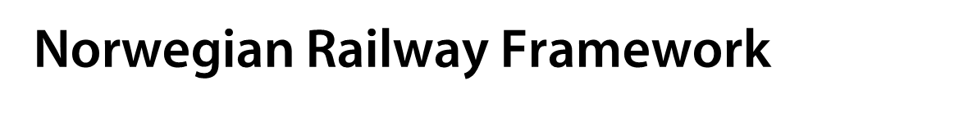
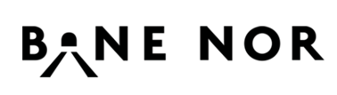
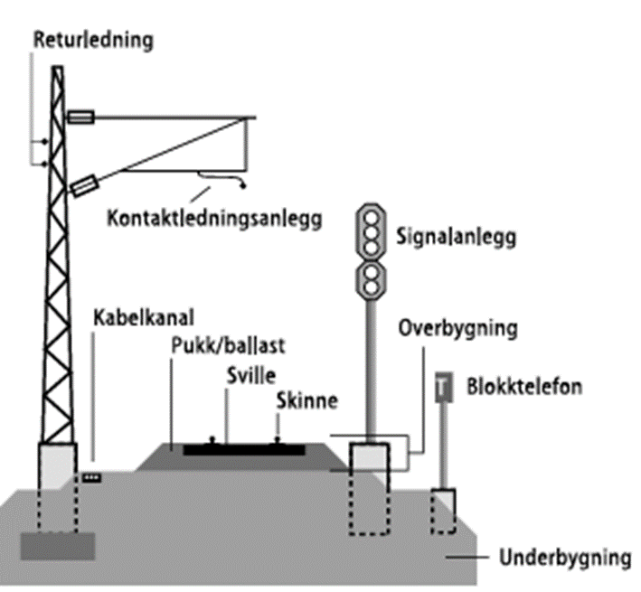


Slide 4
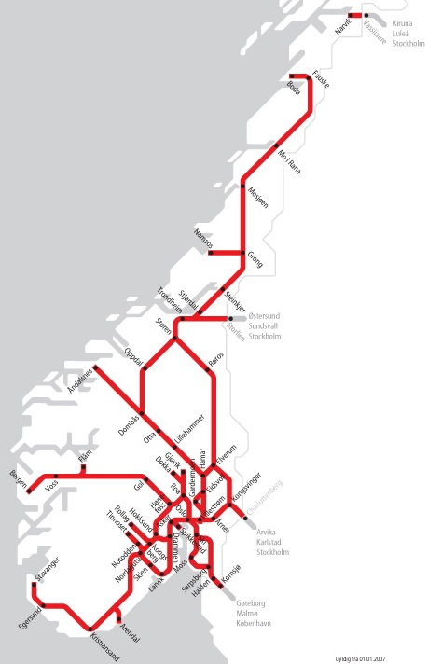
The Norwegian Railway Network
Lines with regular traffic 3 848 km
Double tracks 290 km
Electrified lines 2 451 km
Power supply 15 kV – 16 2/3 Hz
Level crossings total 2 741
Level crossings on public roads 325
Bridges 2 505
Tunnels 686
The network is described in details on http://www.banenor.no/Marked/Informasjon-for-togselskapa
Figures on rail you also find on https://www.jernbanedirektoratet.no/no/jernbanesektoren/jernbanenettet-i-norge/jernbanen-i-norge-i-tall/
Notes:
Sweden: 11 904 km, single track 8099 km, 3731 bridges, 132 tunnels
Denmark : 2342 km, 2342 bridges

Slide 5

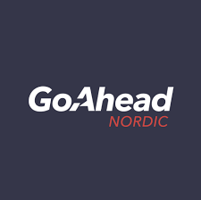


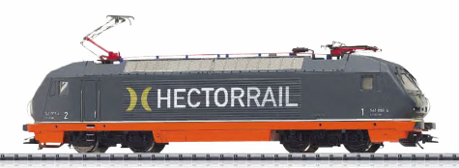
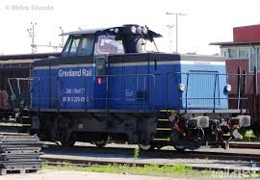
Norwegian Railway Framework
Railway operators
  Passenger transport, National network
    Flytoget AS (Oslo airport- Drammen)
    Go-Ahead Nordic (total network)
    SJ Norge AS (total network)
    TM Togdrift AS (Arctic Train) (Narvik -Swedish boarder)
    Vygruppen AS (total network)
    Freight transport, National network
    CargoNet AS (total network)
    Grenland Rail (total network)
    Hector rail AB (total network)
    LKAB Malmtrafikk AS (Narvik -Swedish boarder)
    On Rail (total network)
    Protrain AB (total network)
    Tågåkeriet I Bergslagen AB (total network)
Notes:
- Operators in alfabethic order
- Freight open for competition as from 1.1.2007.

Slide 6
The NSB Group was renamed the Vy Group as of 24 April 2019.
The Vy Group is one of the largest transport groups in the Nordic countries.

Slide 7
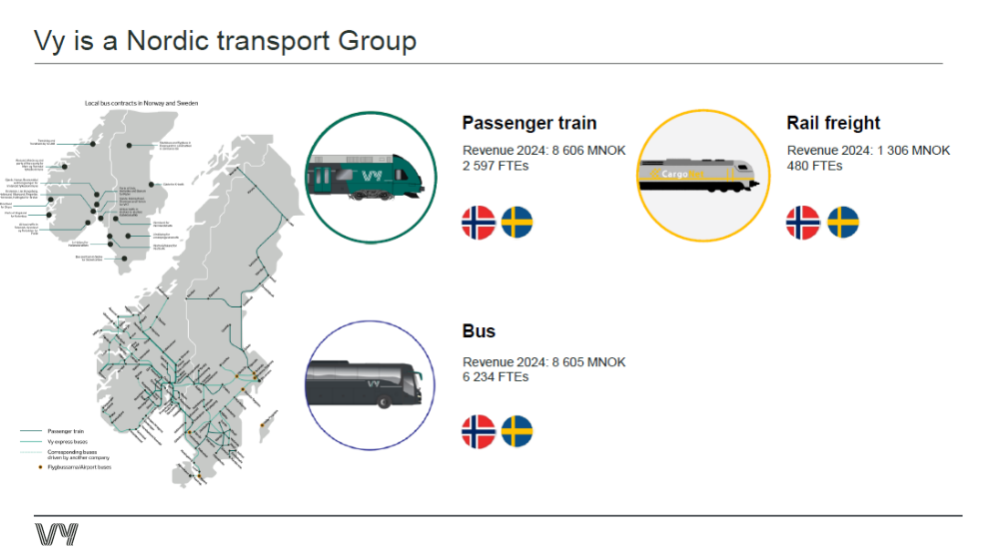

Slide 8
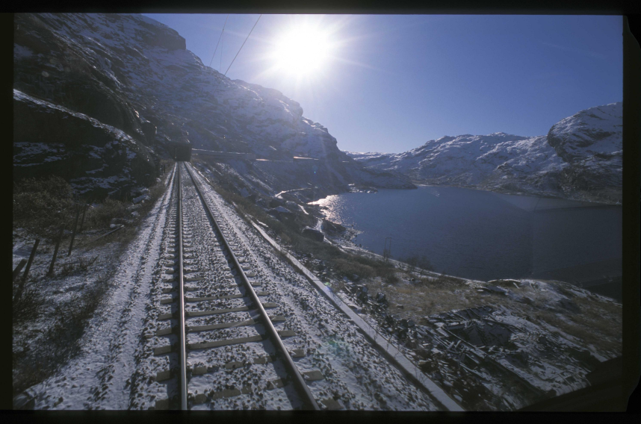
Passenger train – Vy (Norway)
Operates lines in the south-east of Norway and Bergen lines
Operating revenue: NOK 7 billion
2200 FTEs
Rolling stock in operation per 31.12.2025 (main part leased from Norske Tog)
  Electric multiple units 205
  Electric locomotives 13
  Passenger carriages 78

Slide 9

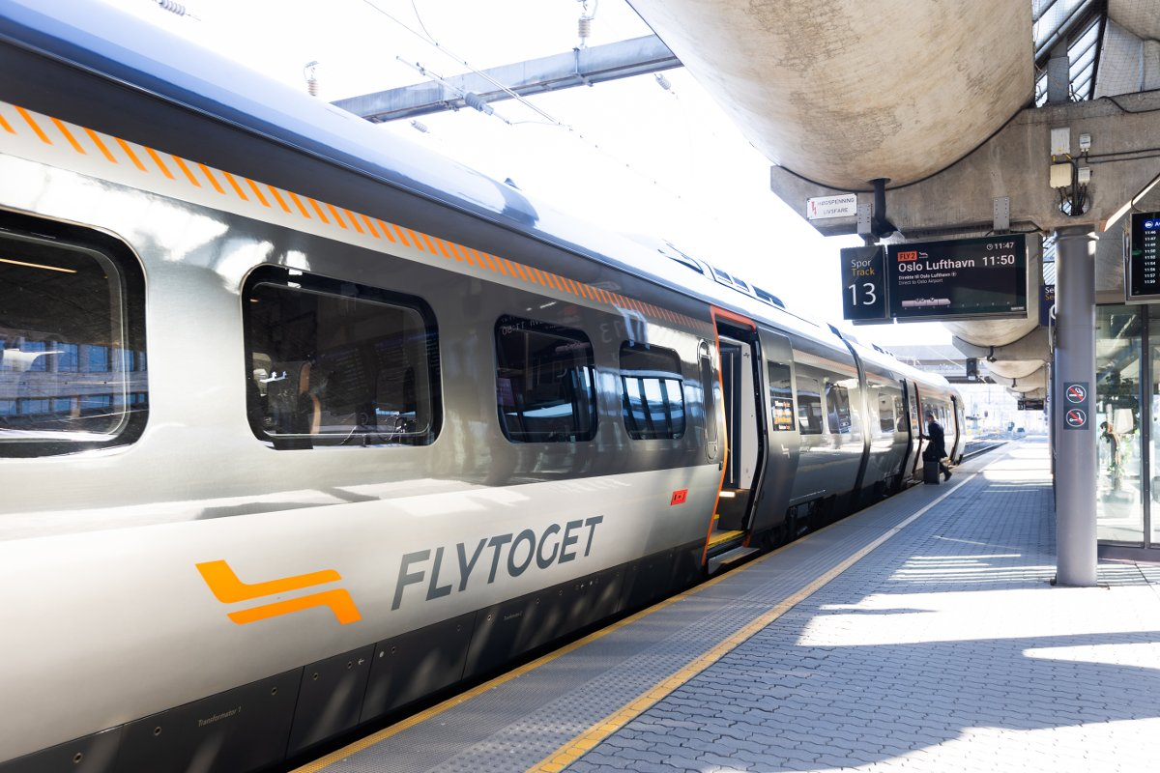
Passenger train – Flytoget AS
Became a subsidiary of Vy 1.4.2025
Operates trains to Oslo airport
Operating revenue:
-NOK 1,0 billion
300 FTEs
More details on: www.vy.no

Slide 10

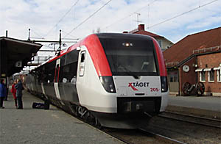
Passenger train – Vy Tåg AB
Operations in Sweden.
X-tåget (until June 2025), Värmlandstrafik, Norrtåg (until Dec. 2025)
Operating revenue:
-NOK 0,8 billion (2024)
-NOK 0,1 billion (2026)
480 FTEs (2024)
More details on: www.vy.se

Slide 11

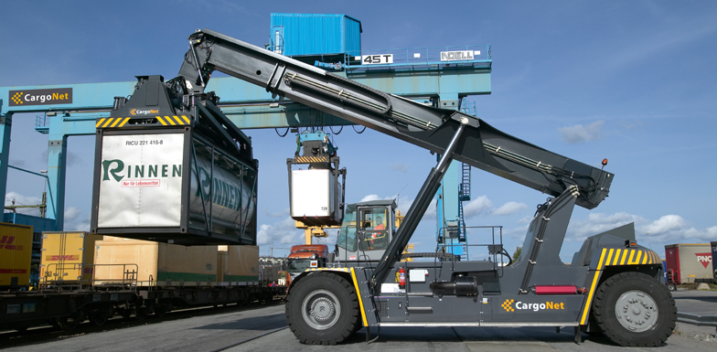
Rail freight
Operating revenue : NOK 1,2 billion
440 FTEs
Access to the European rail network – Partnership with:
  Switzerland - Hupac
  Germany – KombiVerkehr
More details on: www.cargonet.no

Slide 12
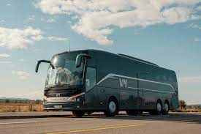
Vy Buss
Operations in Norway and Sweden
Operating revenue:
-NOK 8,6 billion
6200 FTEs
2800 busses
More details on: www.vy.no

Slide 13

Tourism
Within tourism, we sell fjord, mountain and cultural experiences to Norwegian customers, tourists and international tour operators.
The main parts of the activity are operated through the part-owned companies Flåmsbana and Fjord Tours.

Slide 14
Risk Control

Slide 15

Vy - Risk Control
Strategic goal
No accidents causing fatalities, serious injuries or environmental damage

Slide 16
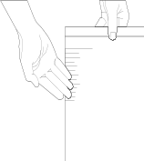
Synergi – Vy’s Risk Management Information System
Synergi
RMIS
Oracle
Accounting
Categories:
Derailment
Fire/Explosion
Accident during entering/leaving train
Collision
Pollution
Incidents in train
Other
All accidents and
incidents are registered
Object
number
Loss
Notification
Front
Insurer

Slide 17
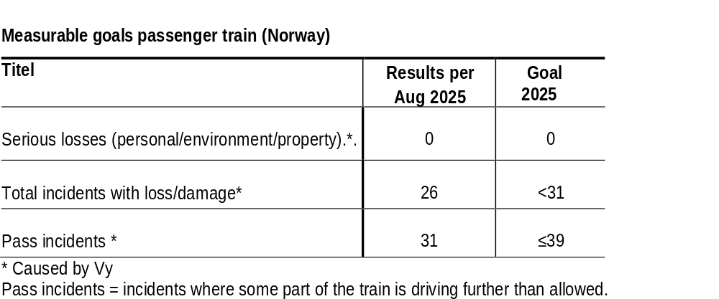

Slide 18
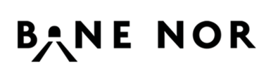
- - Risk Control
Measures
  GSMR - communication between trains and train control - all lines
  ATC – Automatic train control system
  Securing tracks preventing landslides and rockslides
  Preparedness for heavy rain and storms
  Reduction of level crossings
Primary challenges
  level crossings
  unauthorised movements on tracks
  rock- and landslides

Slide 19
PD/BI Insurance
Programme

Slide 20
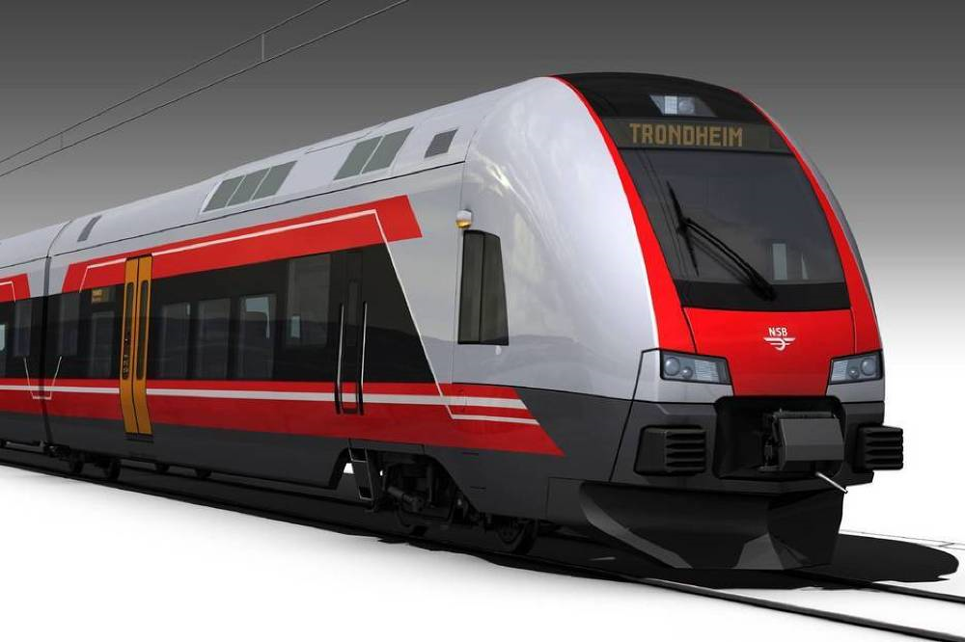
PD Insurance
The main part of passenger trains in Norway are leased from Norske Tog - Vy is additional insured in lessors All-risk insurance with cover for PD and extra costs.
For the underwriting year 1.12.2025 – 30.11.2026 Finse PDBI program will cover rolling stock used in the cargo business, a few passenger trains and a BI cover. Flytoget AS will keep a separate PDBI program for the coming underwriting year.

Slide 21
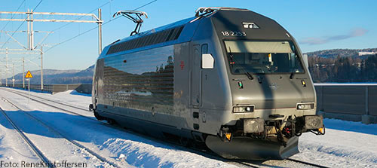
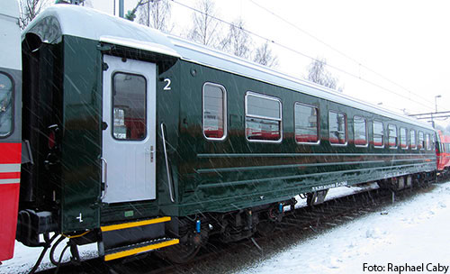
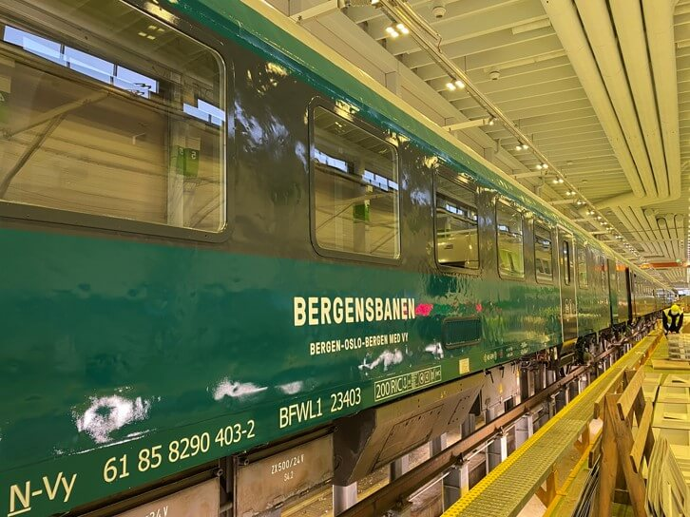
Rolling stock – passenger train

Slide 22
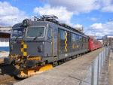
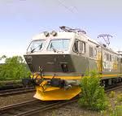

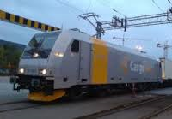
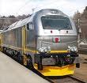

Rolling stock – rail freight

Slide 23
PD/BI Programme
The programme includes all Vy companies owned 50% or more excluding Vy Bus and Flytoget AS
Maximum indemnity per loss MNOK 150
Property Damage - Limit MNOK 150
  Main sublimits
    Inventory MNOK 100
    EDP MNOK 100
    Debris Removal MNOK 50
    Building and assembly MNOK 50
Business interruption - Limit MNOK 100
  Sublimits
    Wages MNOK 100
    Loss of rent MNOK 100
    EDP loss MNOK 50
    Incidents non-Vy MNOK 50
    Extra Expenses MNOK 100
Deductible NOK 1 000 000 per incident and 48/24 hours waiting period
Passenger trains leased from Norske Tog will only be covered for business interruption (ex. Extra expenses)
CargoNet AS: Deductible NOK 2 500 000 (Terminals: NOK 500 000)
Business interruption CargoNet – only cover for extra expenses
Total PD values insured - NOK 2,0 billion (NOK 1,3 billion rolling stock)

Slide 24
Premium/Risk Flow
Vy Group
R/I
R/I
Broker
Front
Insurer
Finse
Forsikring
Notes:
Fronting insurance company (Tryg) handels claims, recourse and keeps 20% of the insurance risk.

Slide 25
Structure PD/BI
MNOK 150 (100%)
20%
Fronter
Reinsurance
MNOK 25 (100%)
Retention Finse
MNOK 20 pr loss, 40 MNOK pr year
Deductible Vy – MNOK 1/ CargoNet - MNOK 2,5/0,5
and 48/24 h waiting period

Slide 26
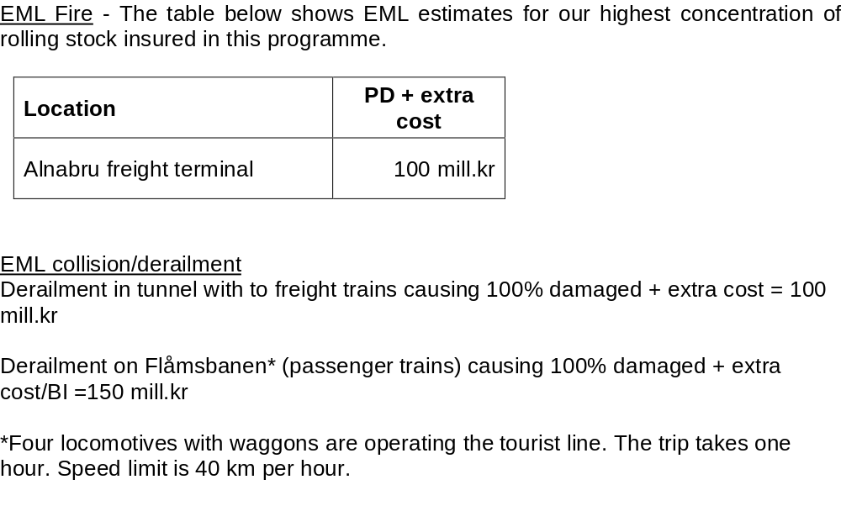
EML

Slide 27
PD/ BI Losses

Slide 28
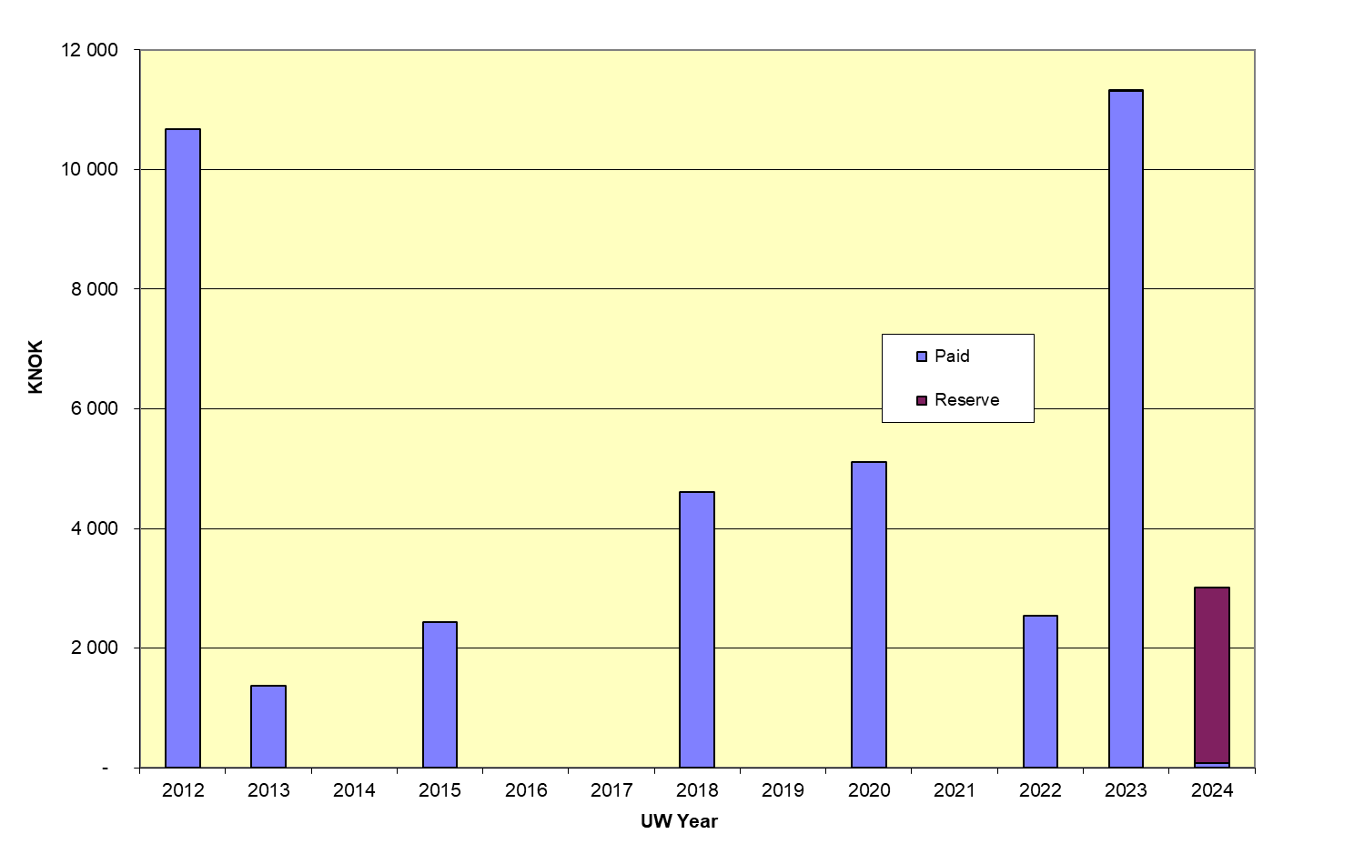
PDBI Losses per uw year (reserve / paid)
Per 31.08.2025 (uw year 2024= 01.12.2024–30.11.2025)

Slide 29
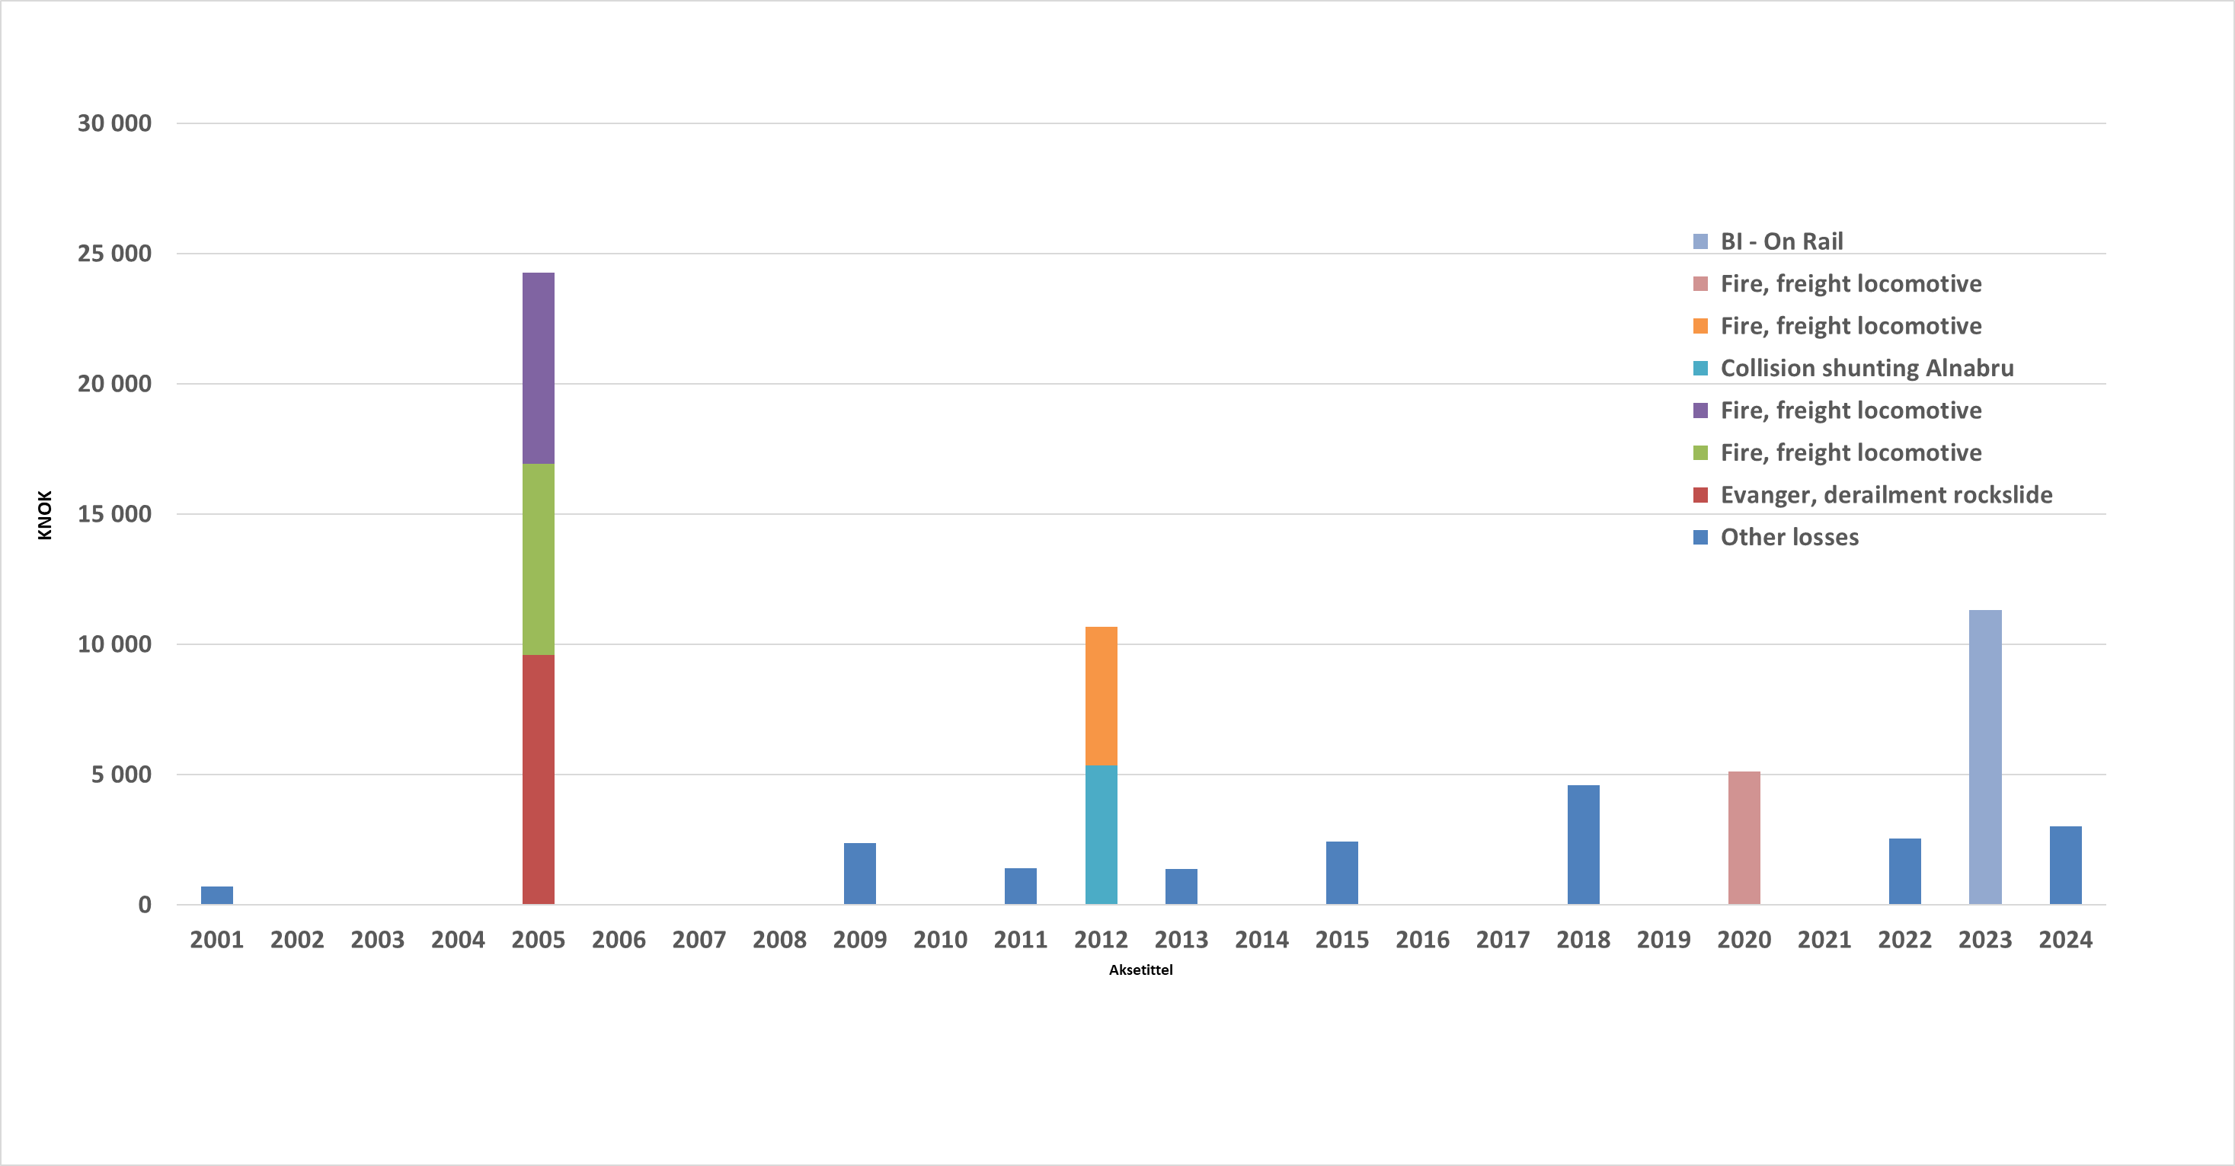
PDBI – per loss (kNOK)
Per 31.08.2025 (uw year 2024= 01.12.2024–30.11.2025)

Slide 30
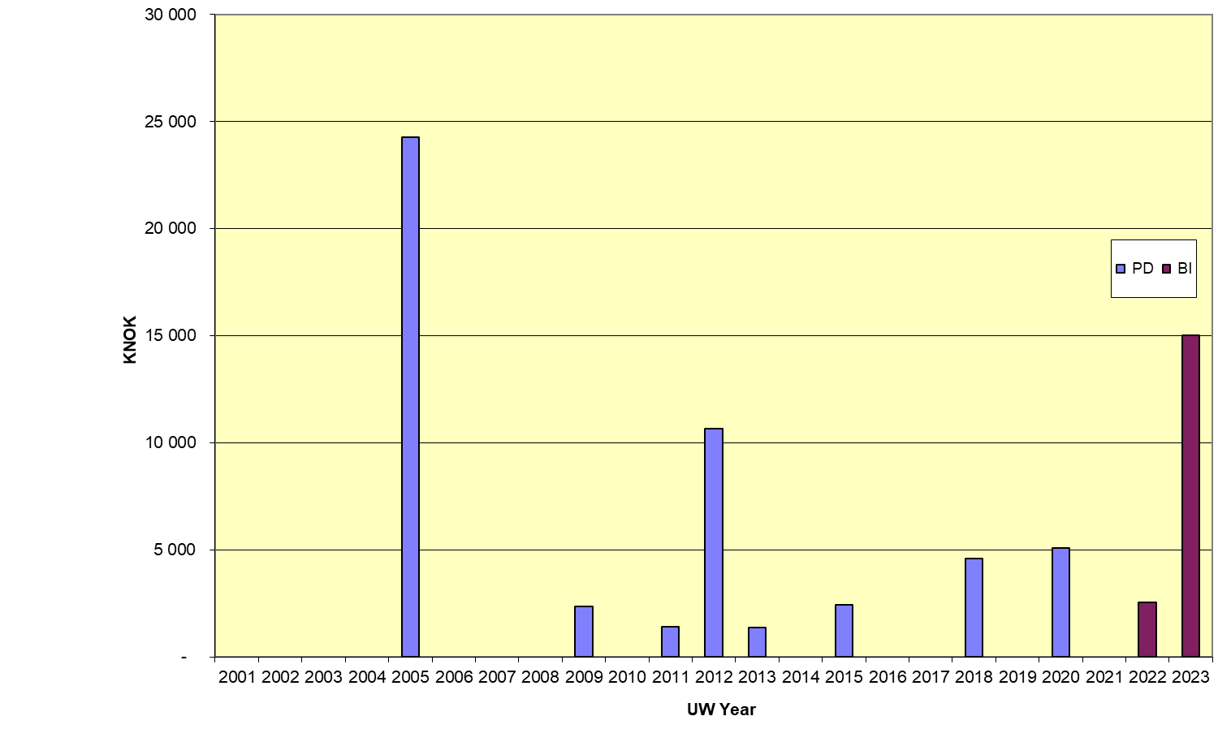
PD - BI – (kNOK)
Per 31.07.2024 (uw year 2023= 01.12.2023–30.11.2024)

Slide 31
Liability
Insurance
Programme

Slide 32
Liability Programme
The programme includes companies in the Vy Group owned 50% or more excluding Vy Bus.
Sum insured NOK 1000 million
Deductible NOK 50 000
Deductible CargoNet/RailCombi NOK 1 000 000 / 250 000

Slide 33
Premium/Risk Flow Liability
Vy Group
R/I
R/I
Broker
Front
Insurer
Finse
Forsikring

Slide 34
Structure liability
MNOK 1000
Layer 2 - MNOK 495 over layer 1
Layer 3 - MNOK 500 over layer 2
Layer 2 - MNOK 495 over layer 1
(100% fronter)
MNOK 500
MNOK 5
Layer 1 - Reinsurance Finse - MNOK 5/MNOK 15
Deductible NOK 50 000/CargoNet MNOK 1/0,250

Slide 35
Liability Losses

Slide 36
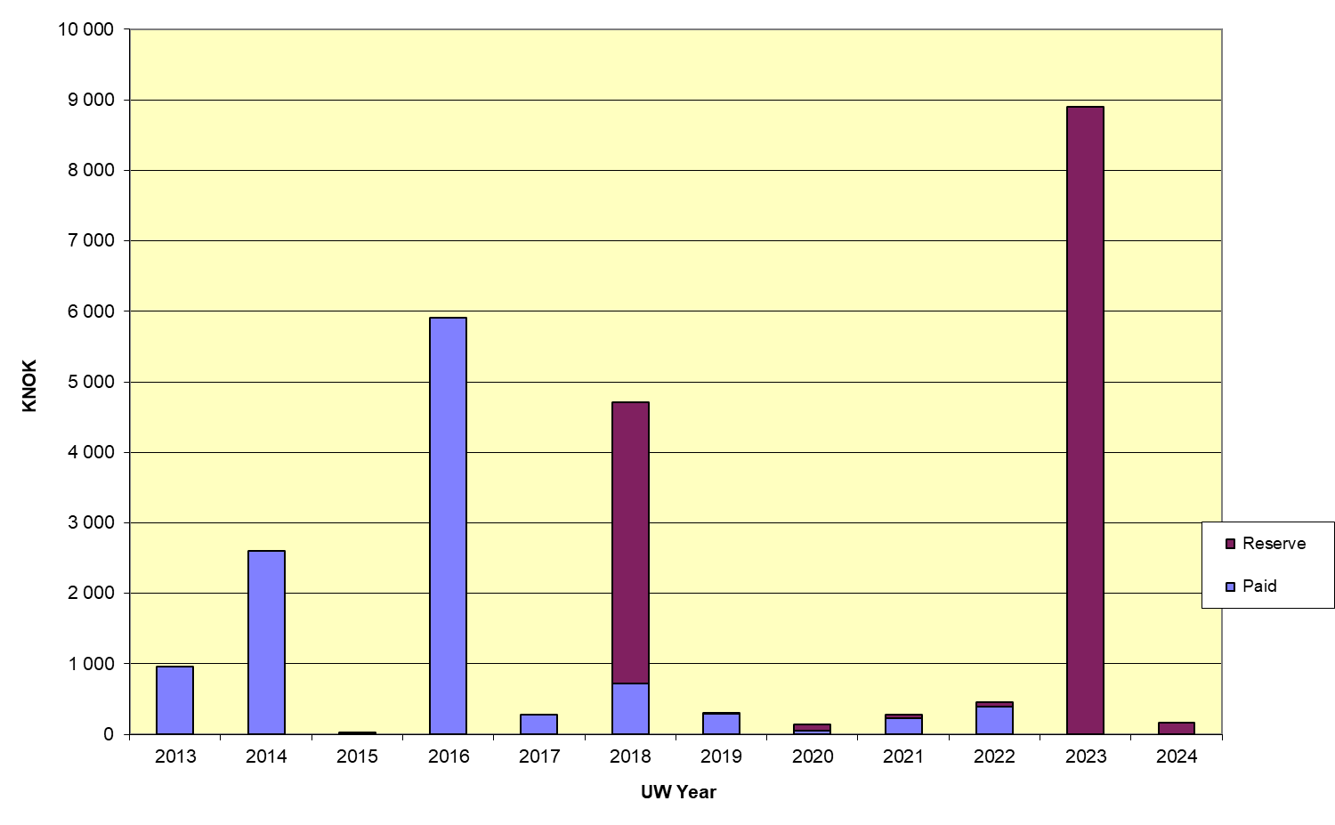
Liability losses per uw year (reserve/paid)
Per. 31.08.2025 (uw year 2024=01.12.2024-30.11.2025)
?

Slide 37
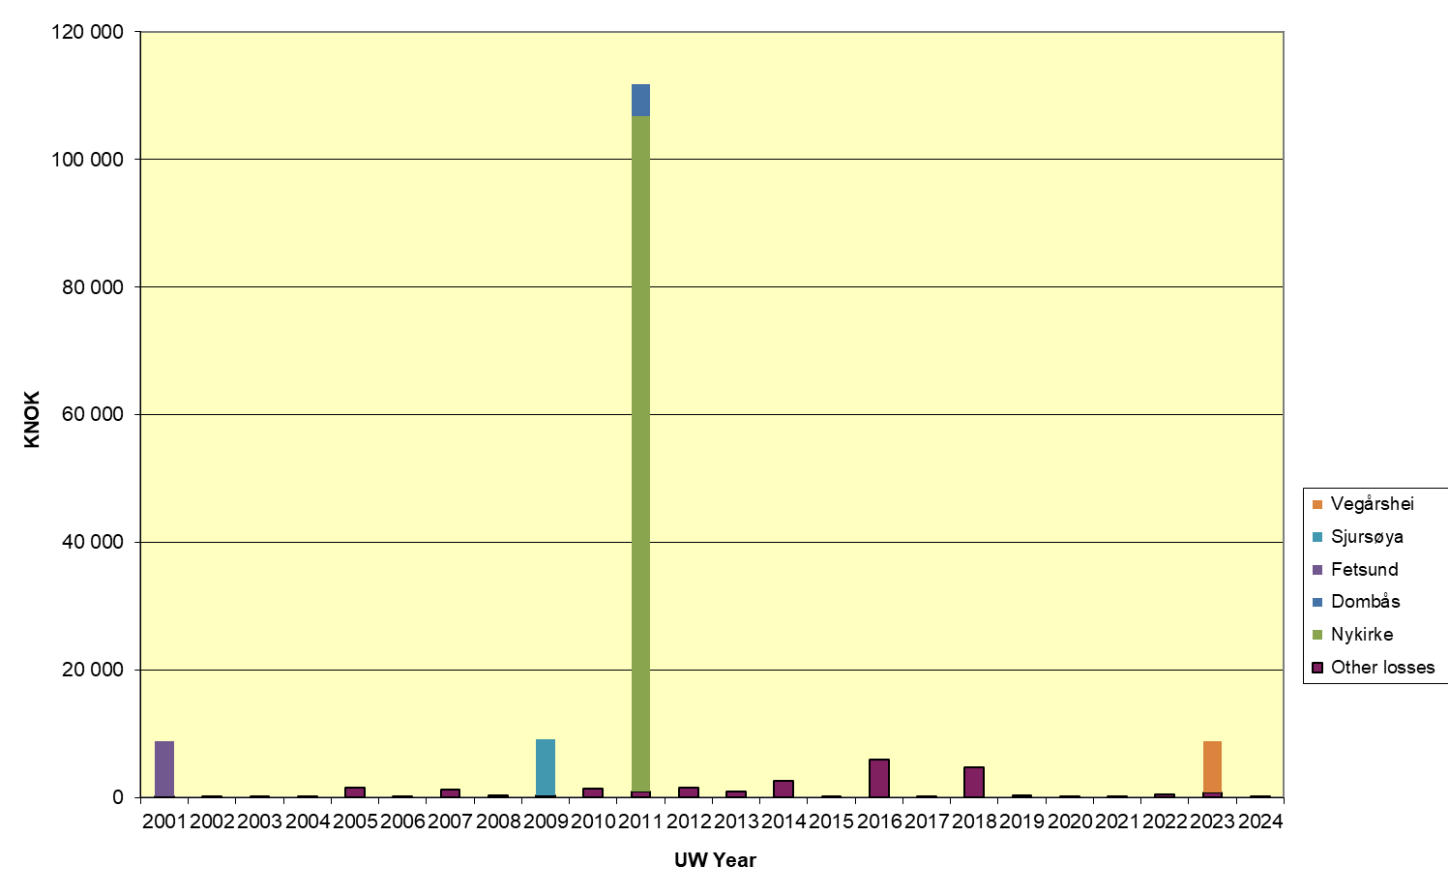
Liability Losses per uw year – major losses per 31.08.2025 (uw year 2024 = 01.12.2024 – 30.11.2025) losses > 5 mill.kr specified

Slide 38
Renewal 01.12.2025 - Timetable
16.09.2025 Underwriting information available for
insurers
at https://www.vy.no/en/finse-forsikring
01.12.2025 Inception date new insurance arrangements

